Slide 1

Guided Capstone Project Report
Leonardo Leal

Slide 2
Problem Identification
Big Mountain Resort
11 lifts
2 T-bars
1 magic carped for novice skiers
Longest run - 3.3 miles length
Summit – 6,817 ft with vertical drop of 2,353 ft
350,000 expected visitors
Ticket Prices: $81.00
Recently installed additional chair
$1,540,000 additional operating costs

Slide 3
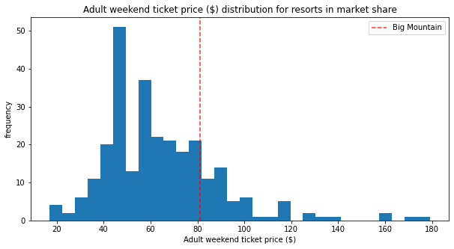
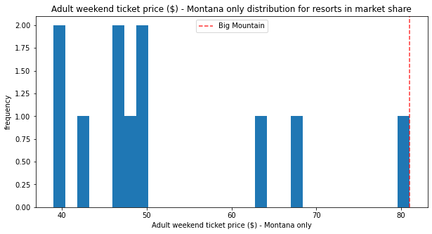
Modeling/Key Fidings
Big Mountain Resorts actual price: $81.00
Big Mountain Resorts modeled price: $94.87
Mean Absolute Error: $10.39

Slide 4
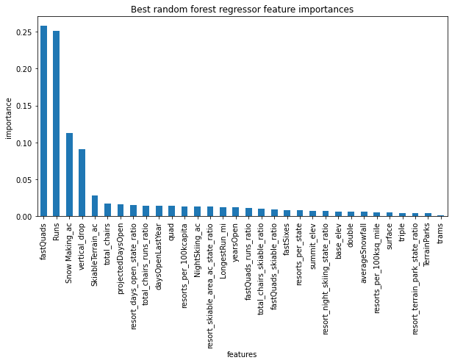
Modeling/Key Fidings (cont.)
8 key features
Vertical Drop
Snow Making
Total Chairs
Fast Quads
Runs
Longest Run
Trams
Skiable Terrain

Slide 5
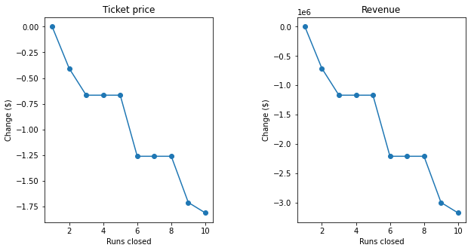
Modeling/Key Fidings (cont.)

Slide 6
Recommendations
Scenario 1
Scenario 2
Close 3 to 5 runs
Save on maintenance cost.
Increase runs by 1 and vertical drop by 150 ft and add 1 more lift chair
Allow ticket raise of $1.99

Slide 7
Conclusion
Big Mountain Resort can opt from 2 options to offset the additional operational costs:
Save costs by closing runs.
Increase ticket prices by improving services provided.
More detailed study could be made with better results:
Study made with adult weekend ticket prices only.
Kids ticket prices and detailed maintenance costs data not available.

